Slide 1
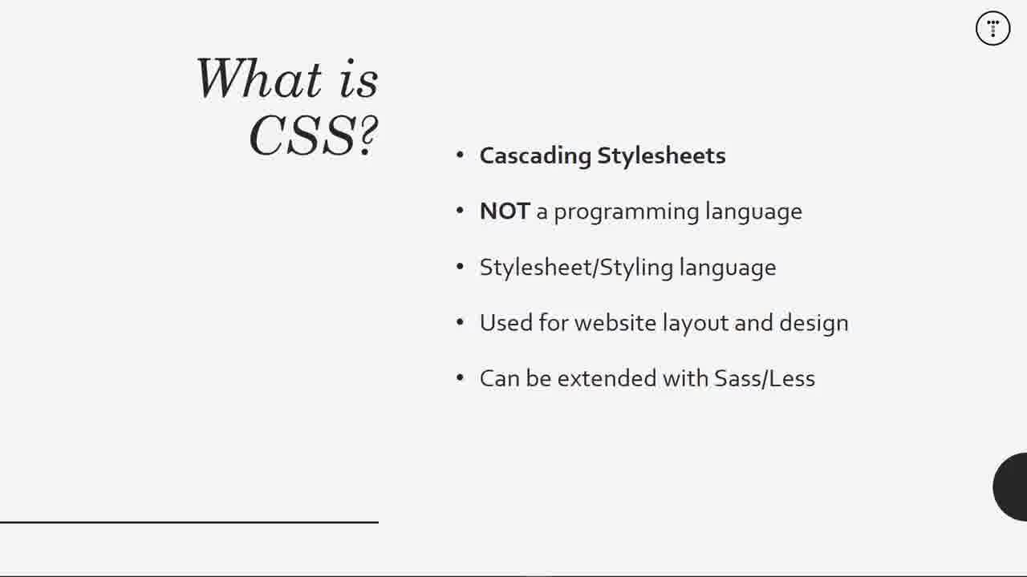

Slide 2
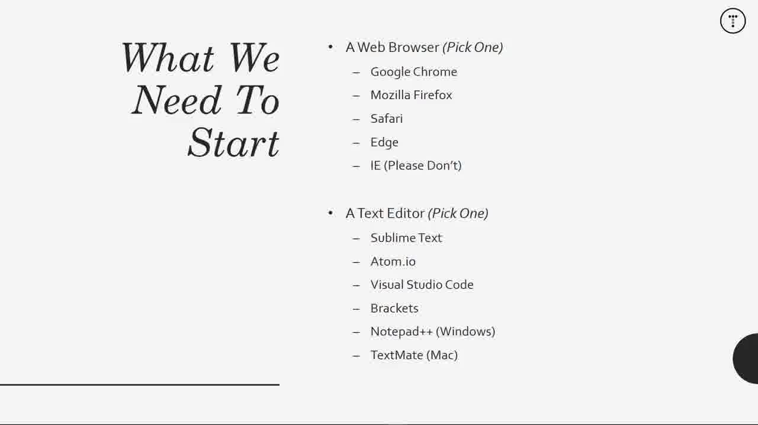

Slide 3
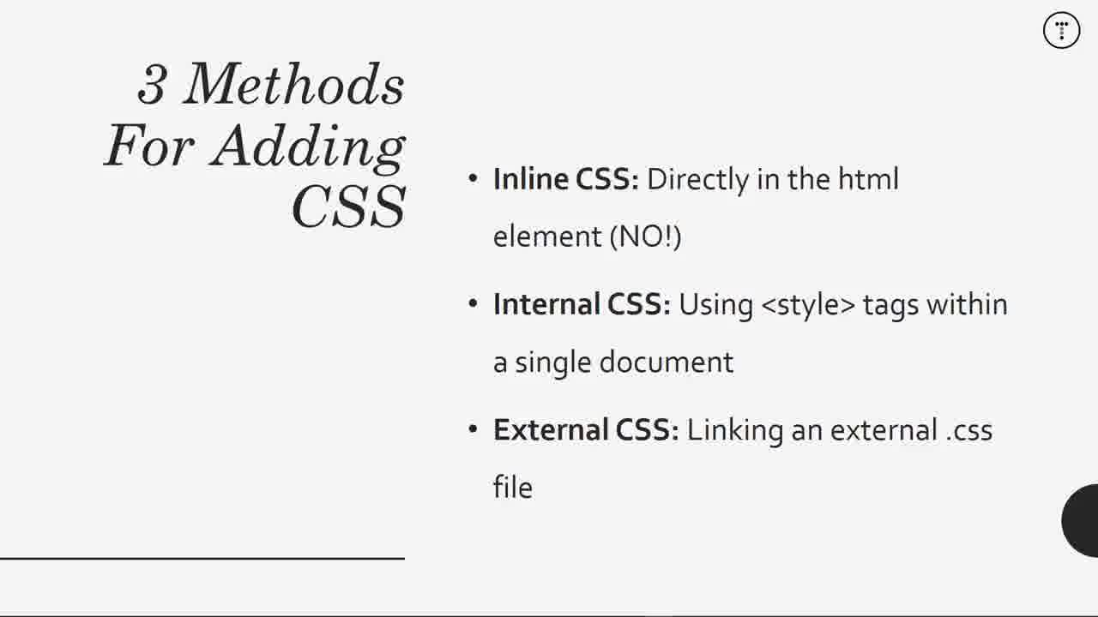

Slide 4
1. With an external file that you link to in your web page:
or using the import method:
<link href="myCSSfile.css" rel="stylesheet" type="text/css">
<style type="text/css" media="all"> @import "myCSSfile.css"; </style>
2. Internal
<head>
<style type="text/css">
p { padding-bottom: 12px; }
</style>
</head>
3. By inserting the CSS code right on the tag itself:
<p style="padding-bottom:12px;">Your Text</p>

Slide 5
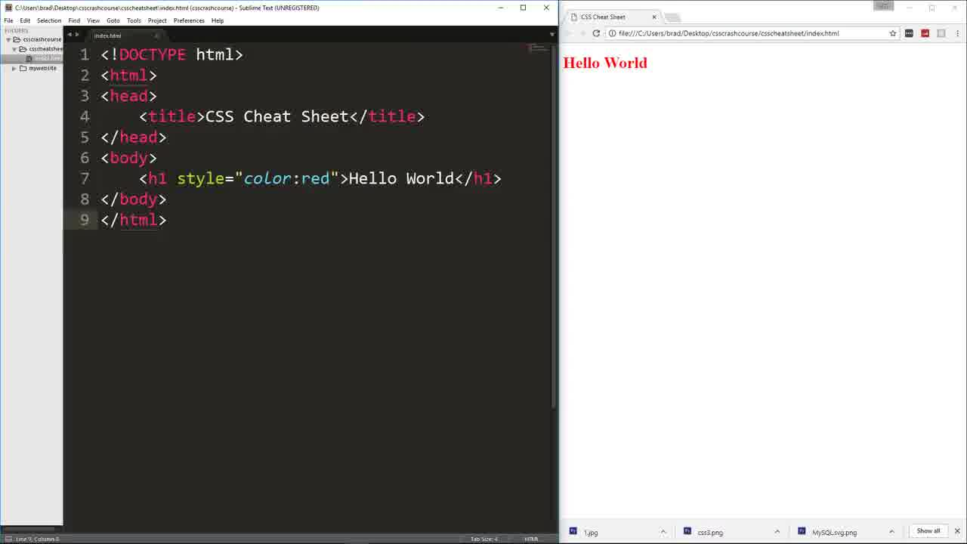
inline

Slide 6
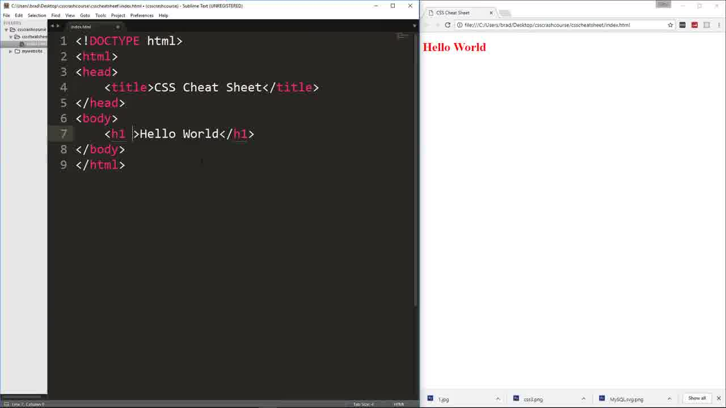

Slide 7
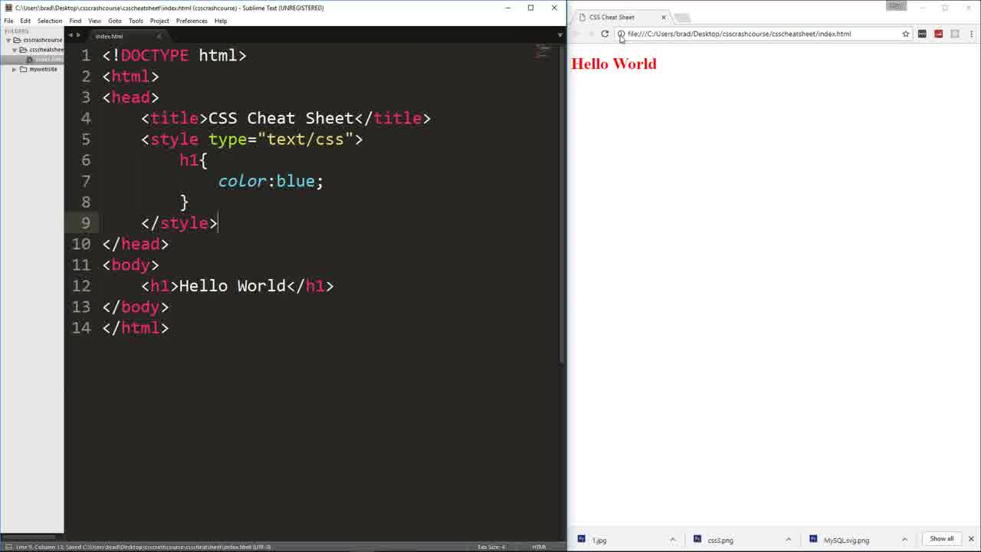
internal

Slide 8
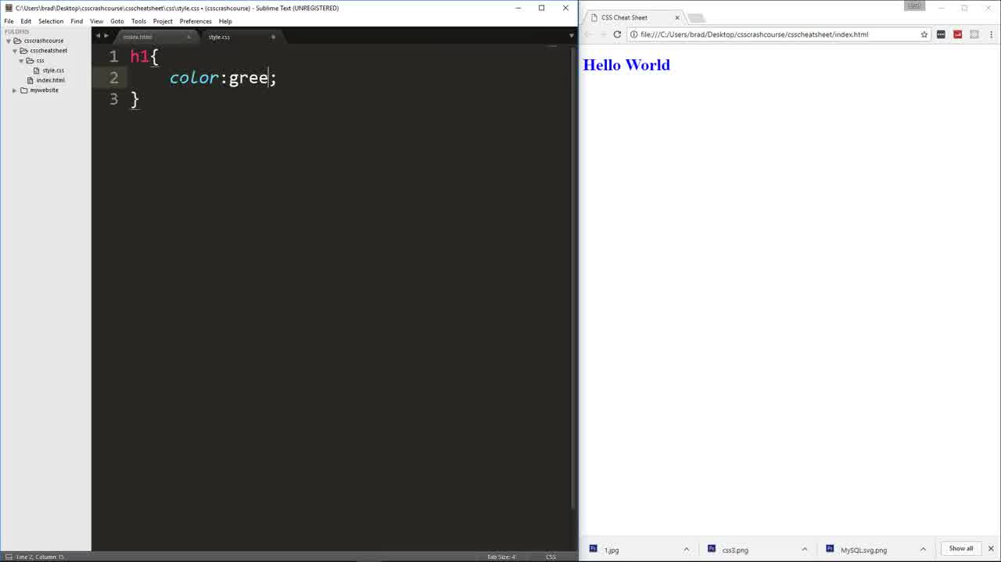
1
selector
external

Slide 9
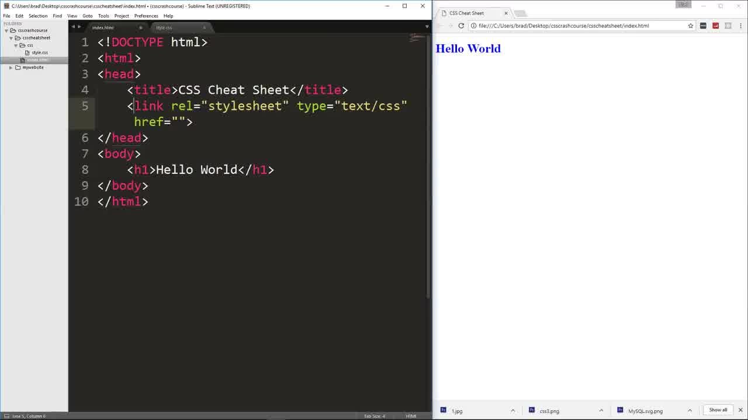
2e
external

Slide 10
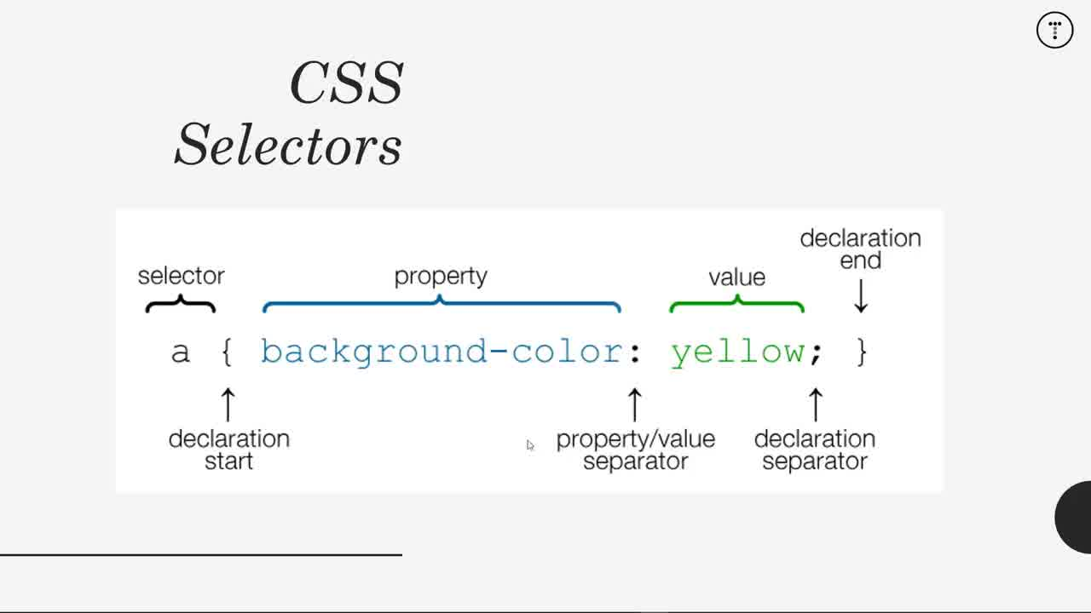
Value 沒有雙引號

Slide 11
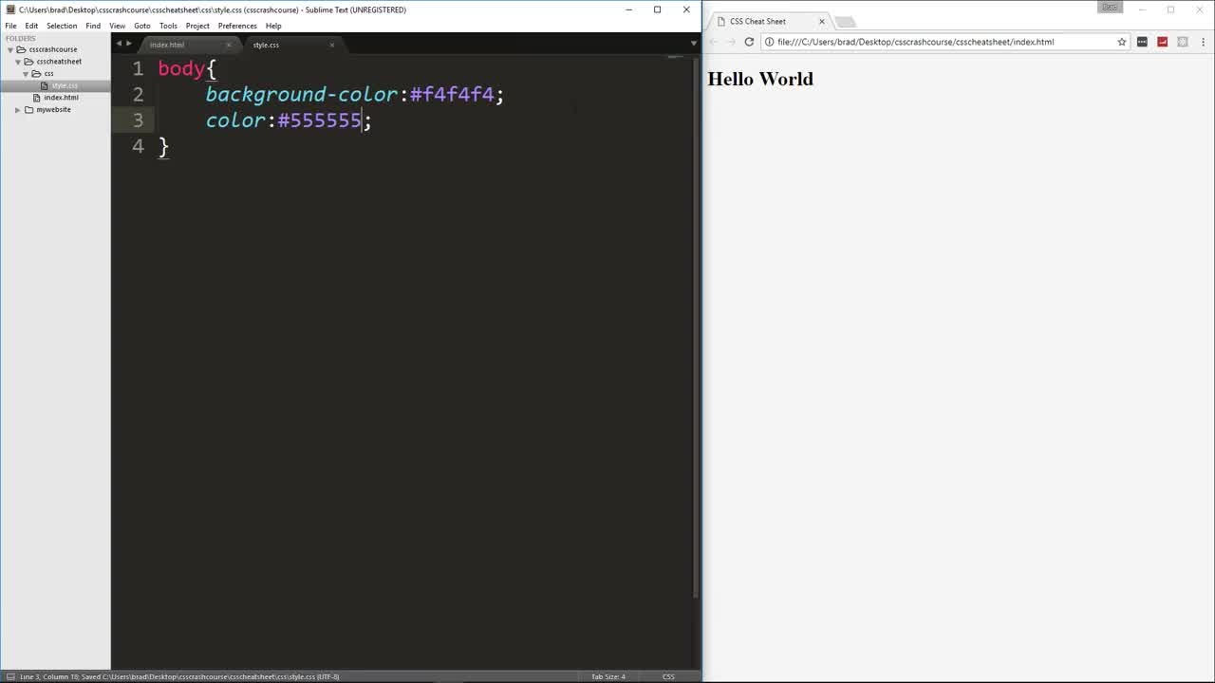

Slide 12
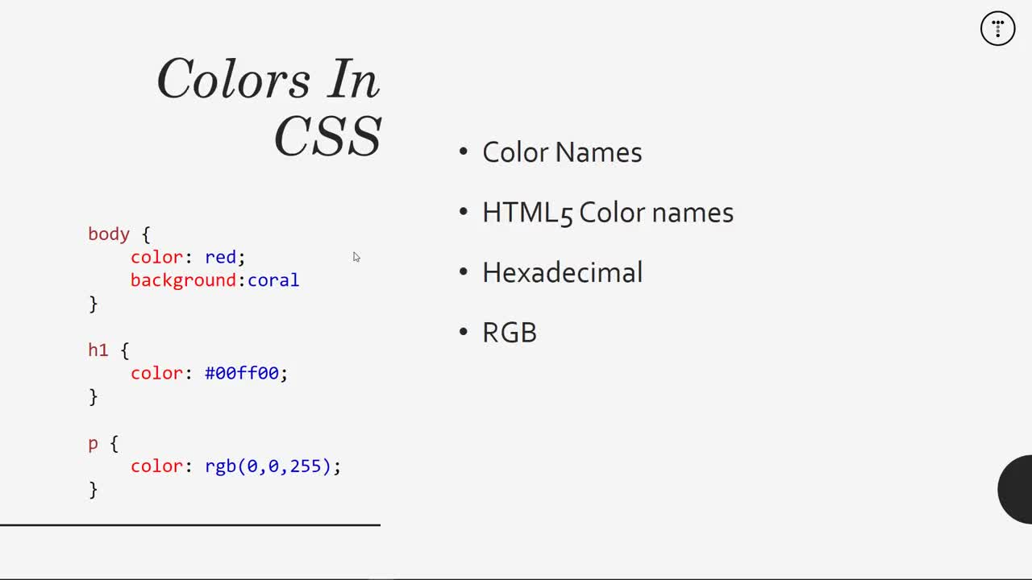

Slide 13
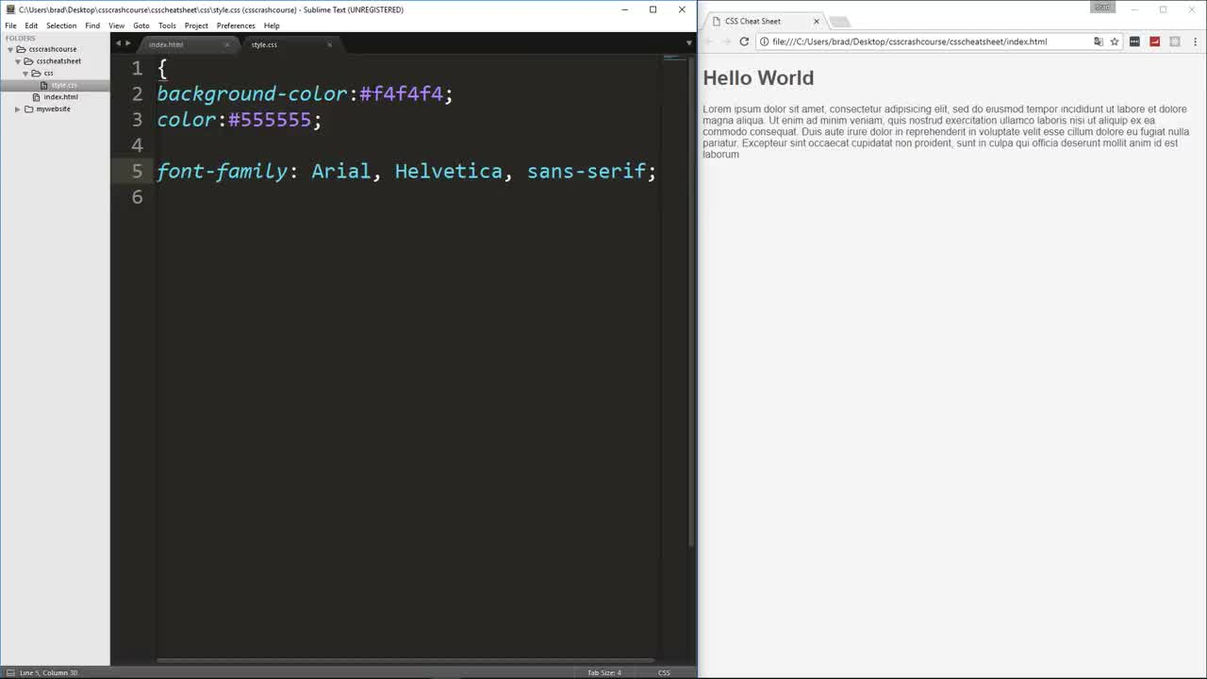

Slide 14
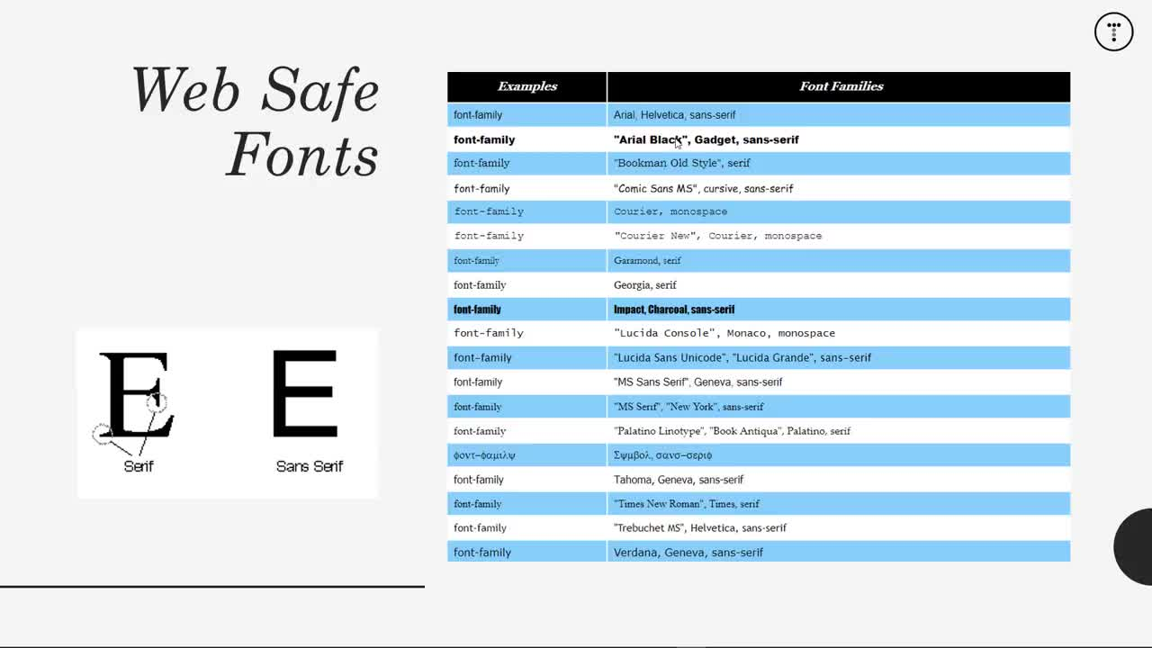

Slide 15
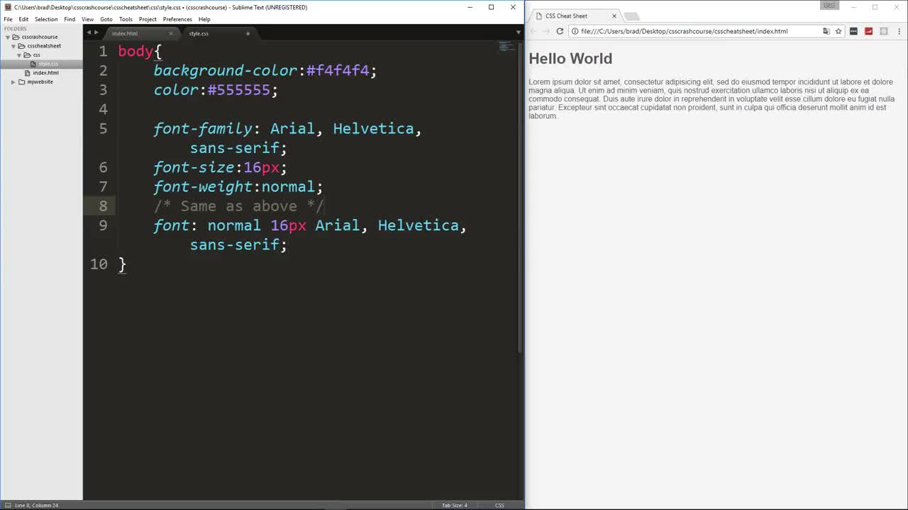
可以簡寫
body{
background-color:#f4f4f4;
color:#444444;
font-family: Arial,Helvetica,sans-serif;
font-size:16px;
font-weight:normal;
font: normal Arial,Helvetica,sans-serif;
}

Slide 16
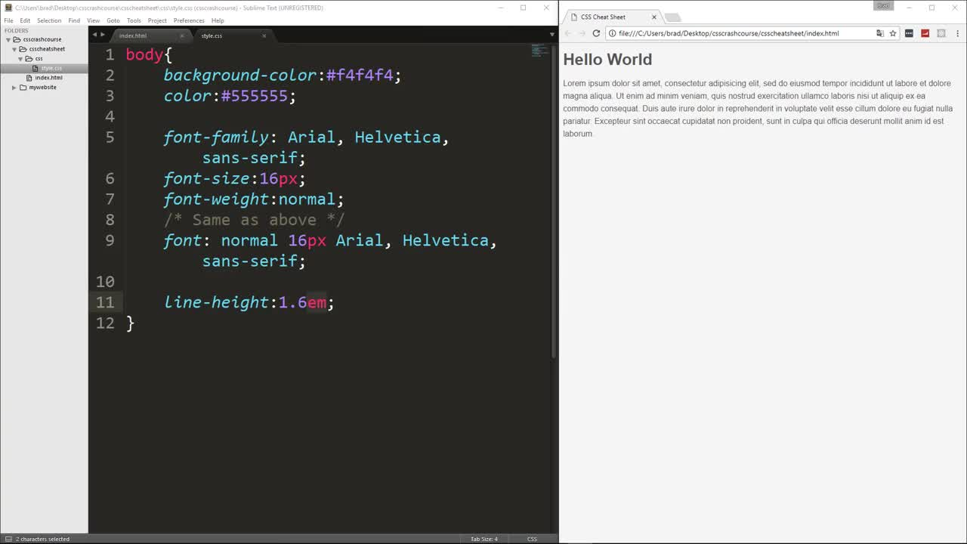

Slide 17
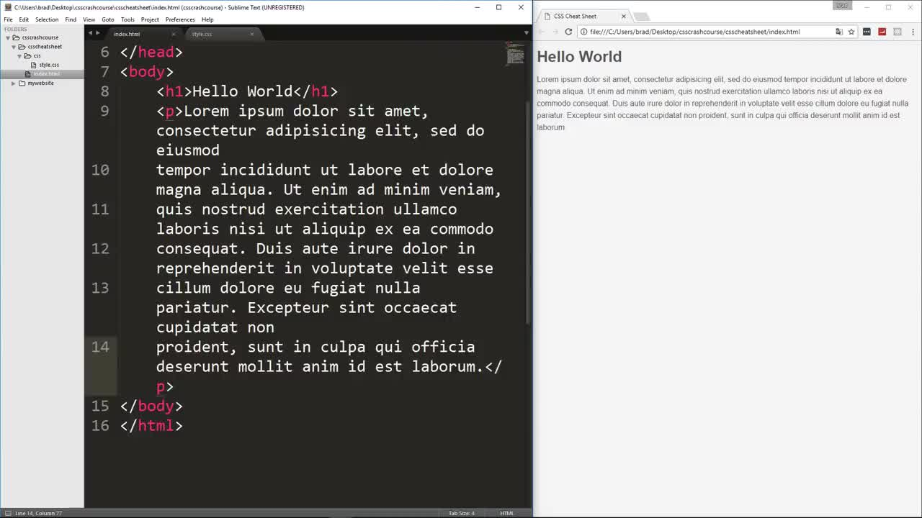

Slide 18
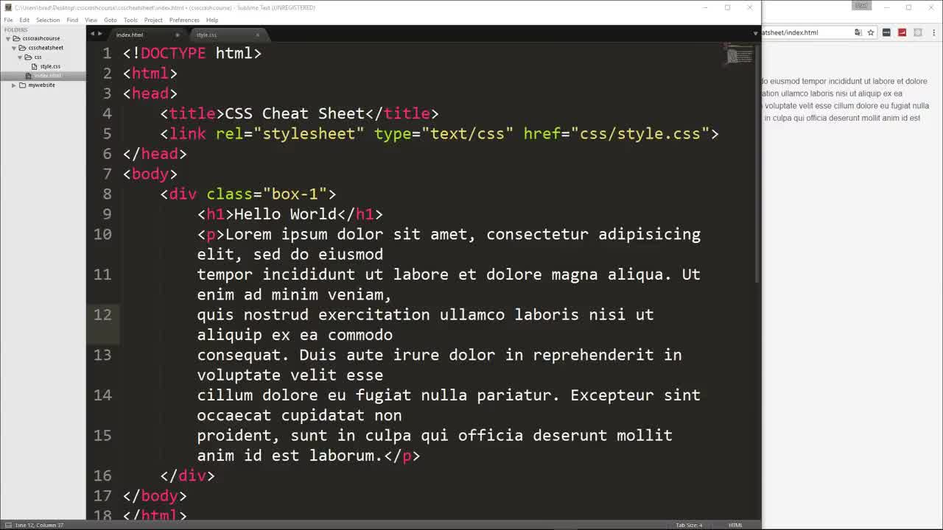
box-1

Slide 19
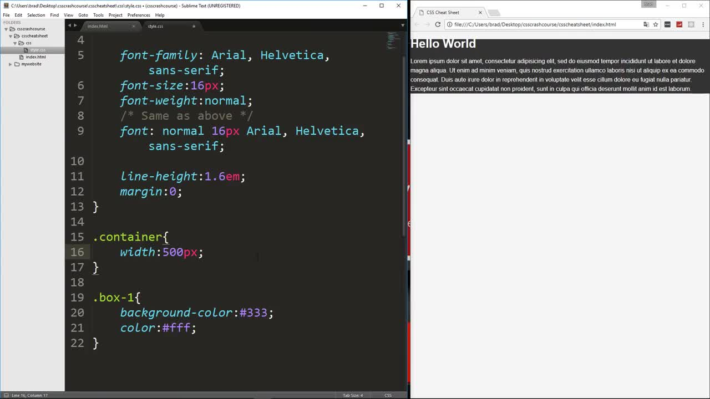
.container {
width:500px;
}
.box-1{
background-color:#333;
color:#fff;
}

Slide 20
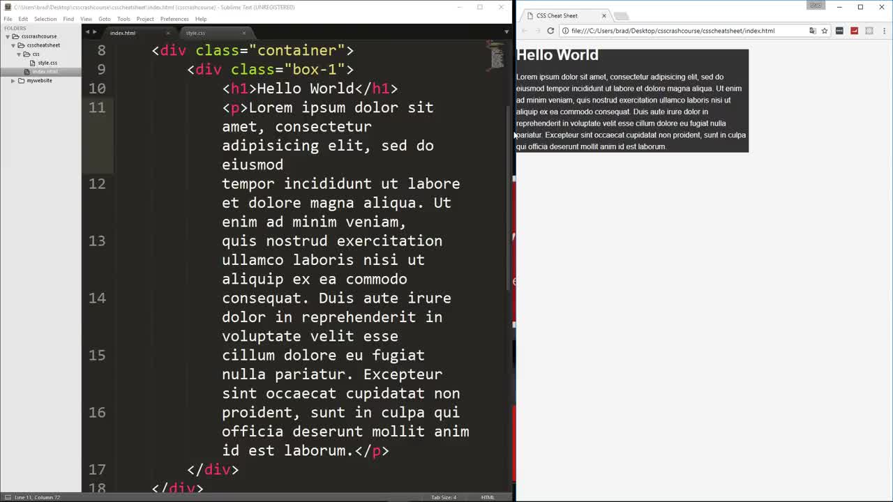
container

Slide 21
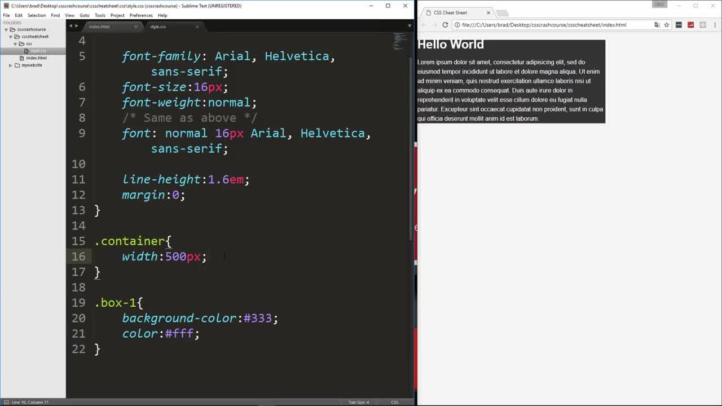

Slide 22
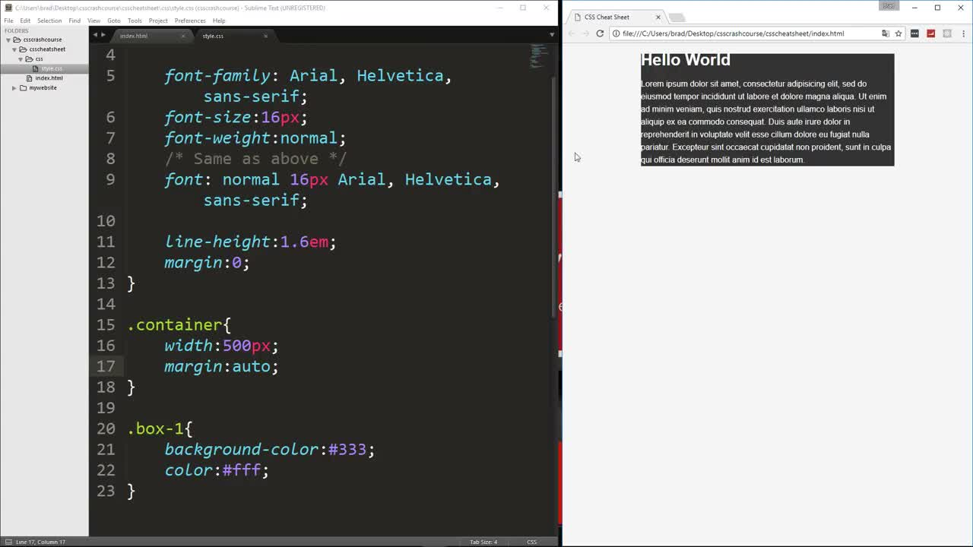
自動留有空白

Slide 23
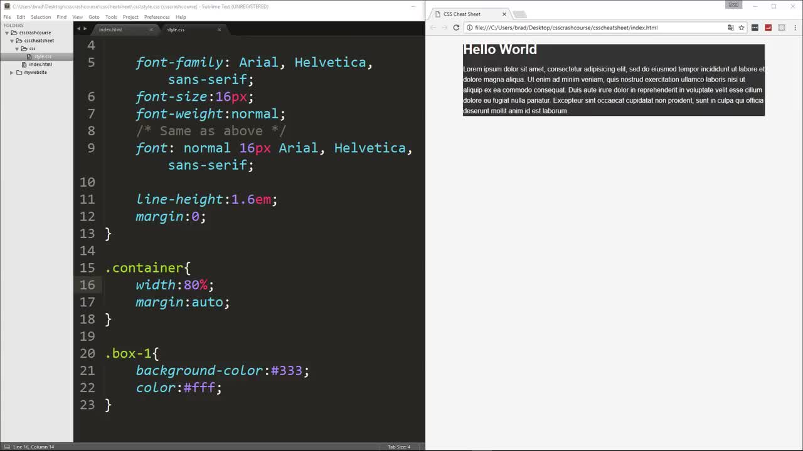

Slide 24
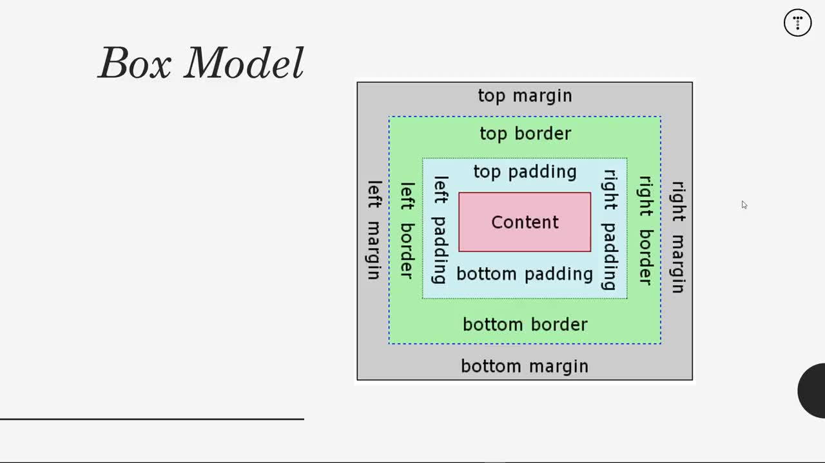

Slide 25
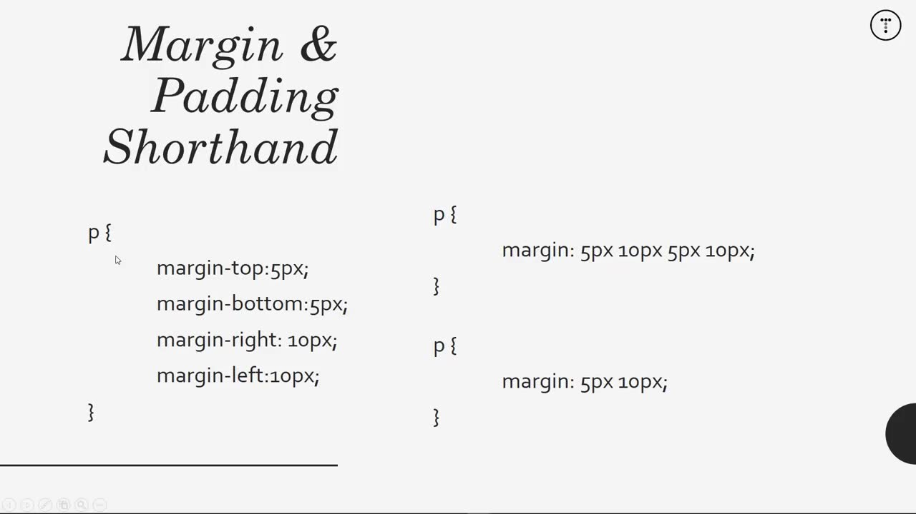
top,right,bottom,left
top,bottom 5px
left,right 10px

Slide 26
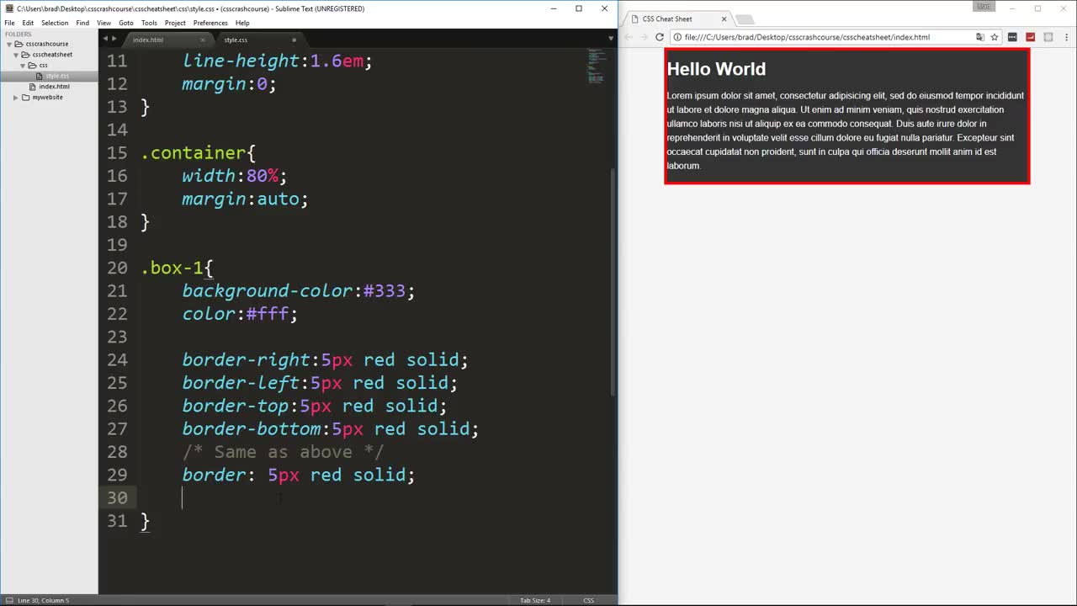

Slide 27
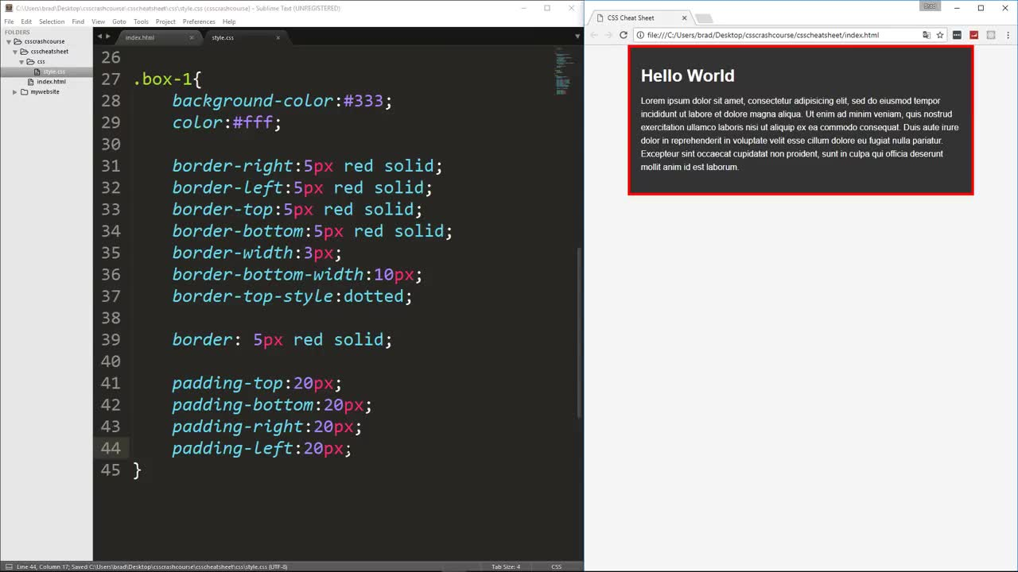

Slide 28
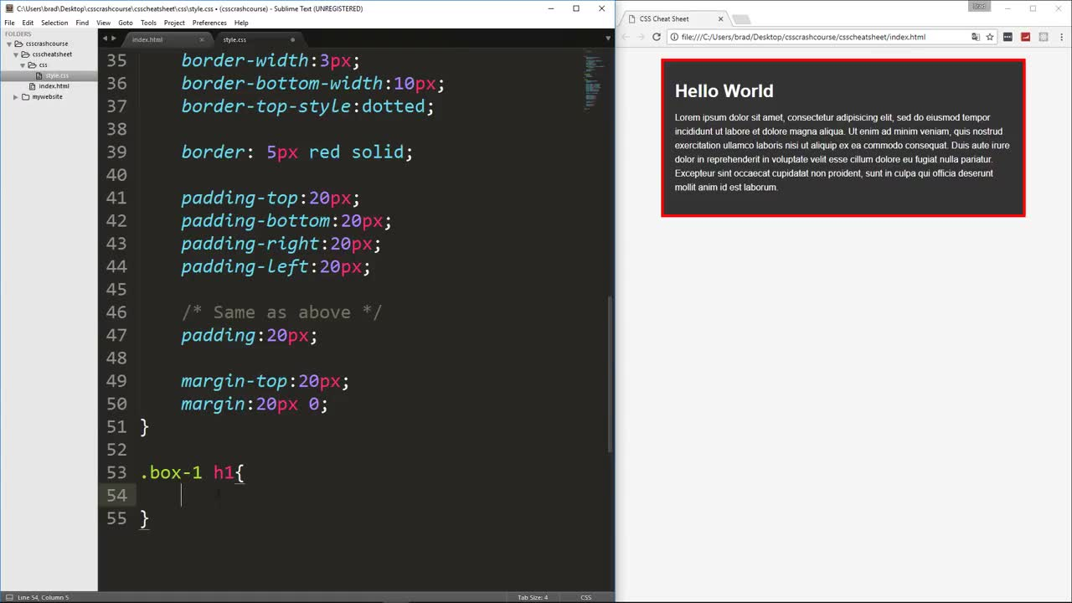

Slide 29
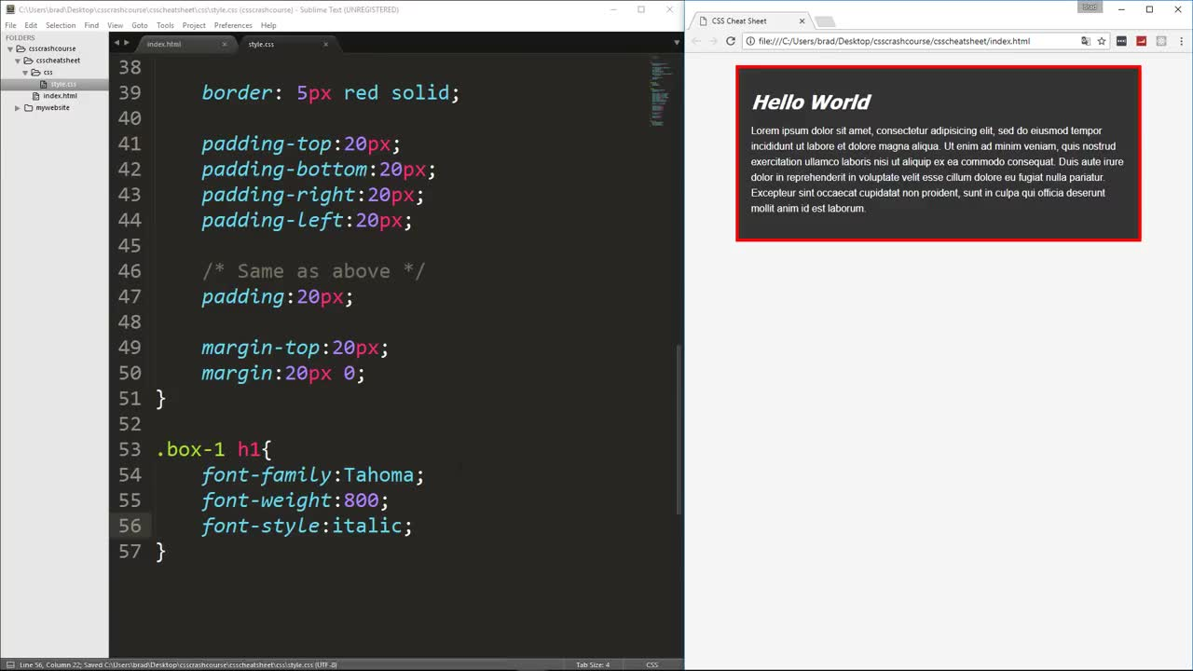

Slide 30
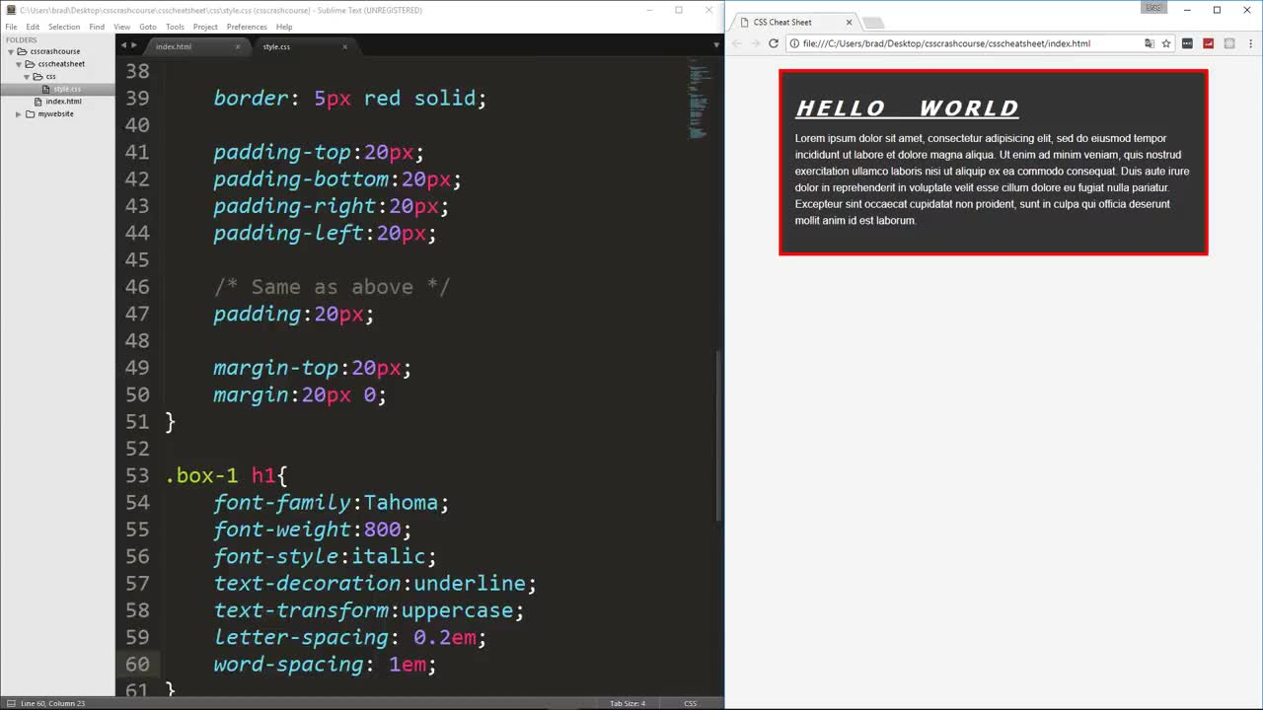

Slide 31
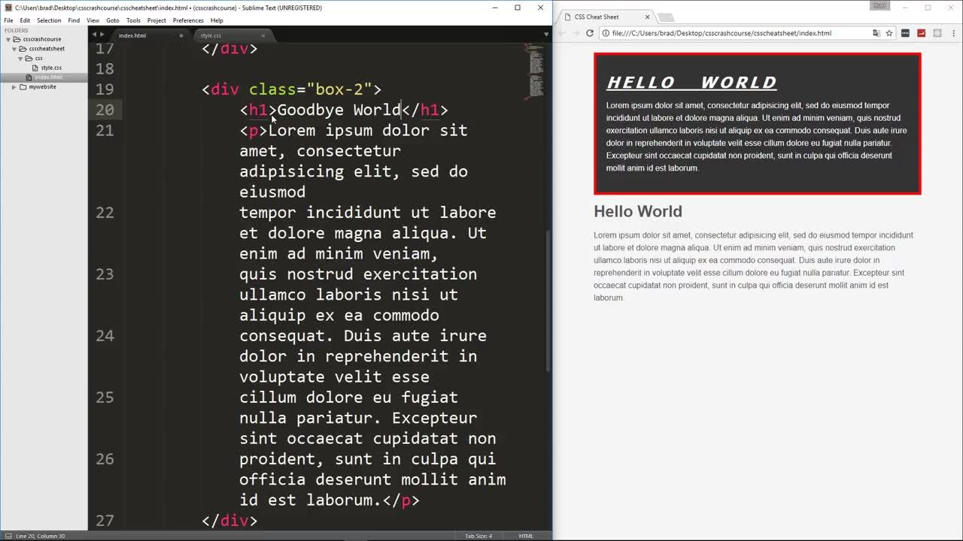
add anoaather <div>

Slide 32
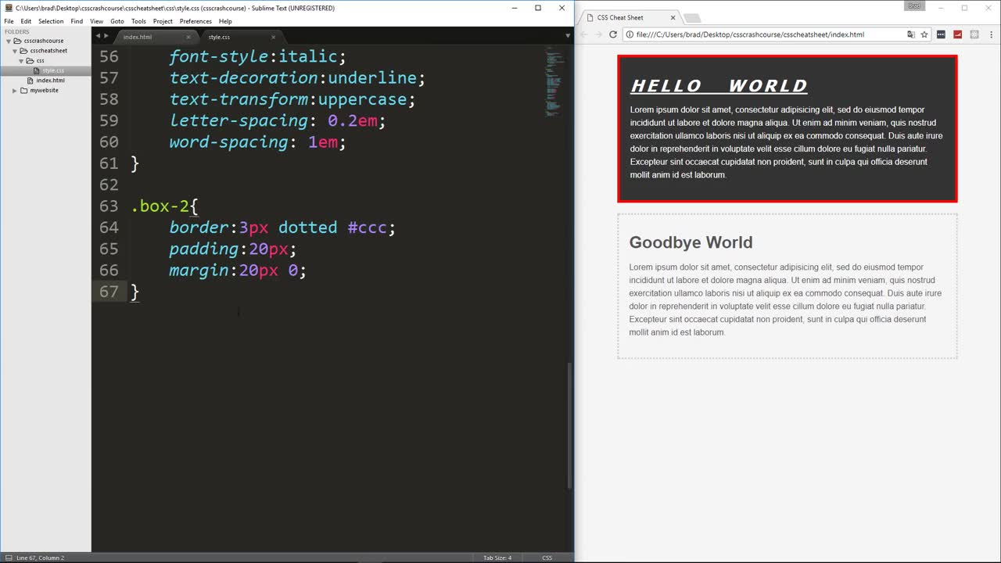

Slide 33
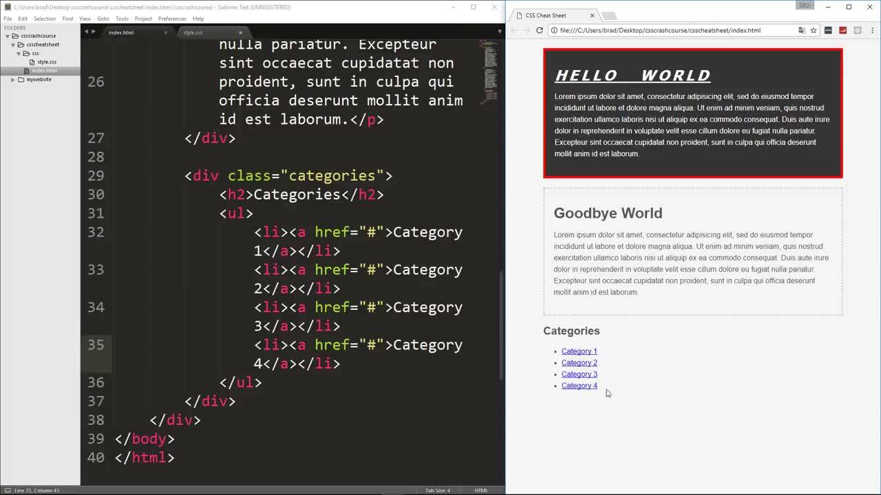
add another div

Slide 34
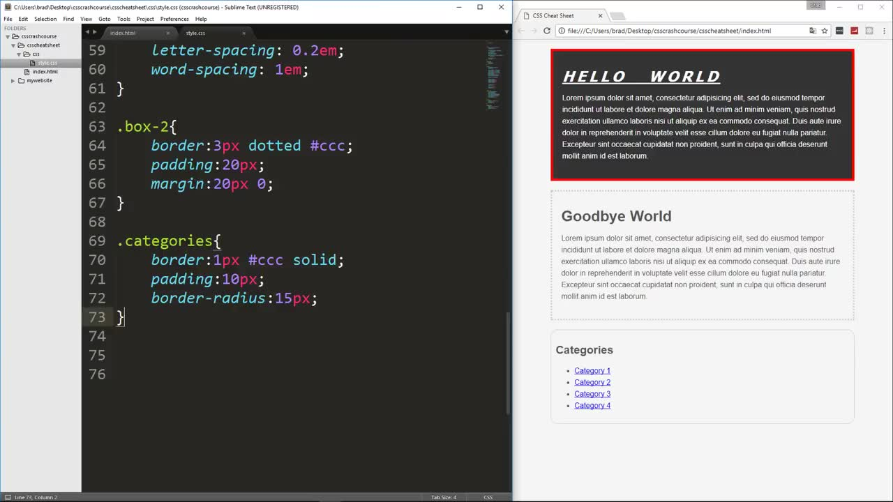

Slide 35
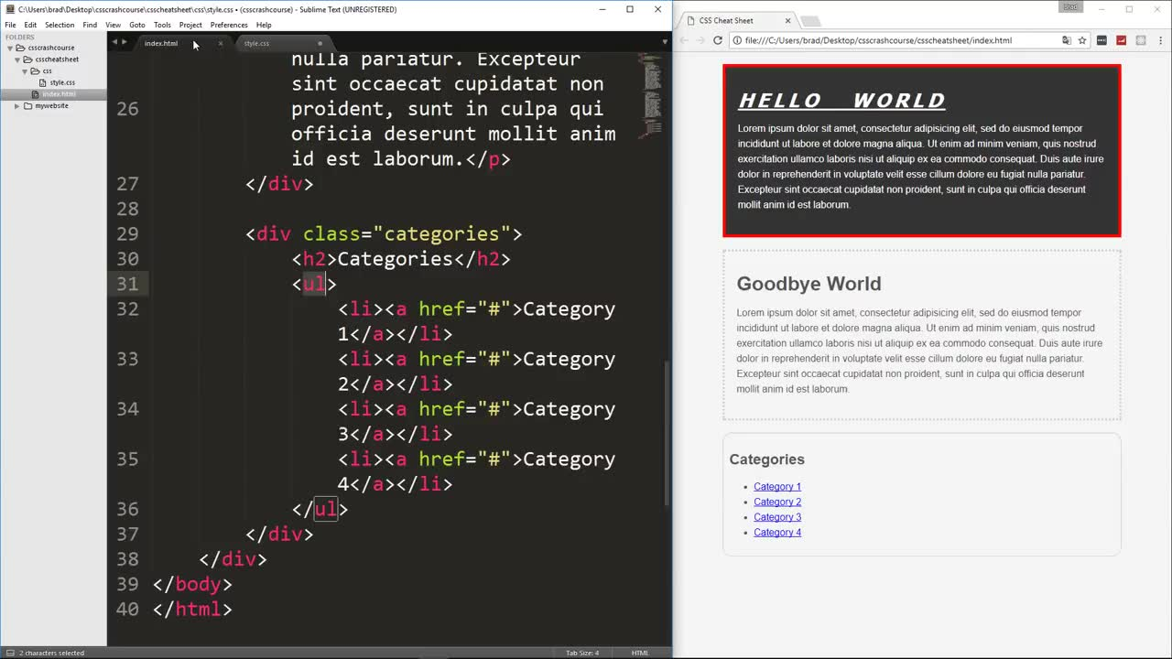

Slide 36
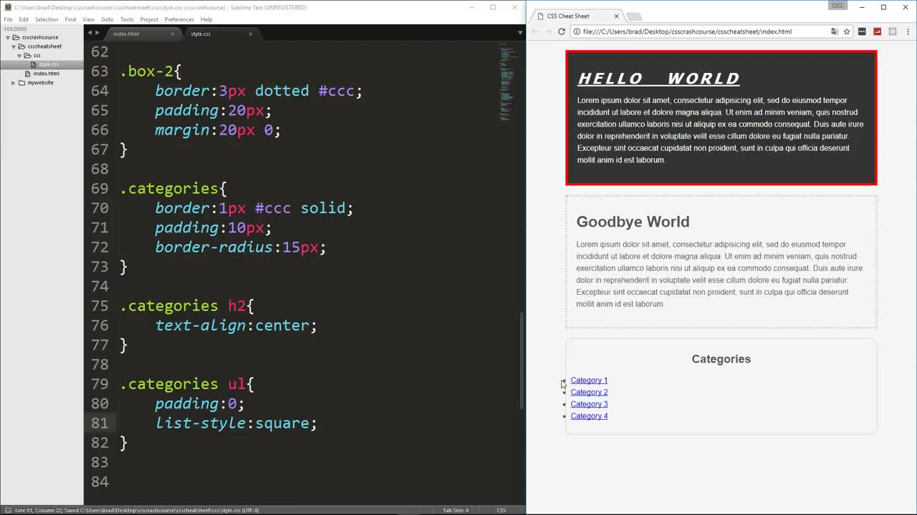

Slide 37
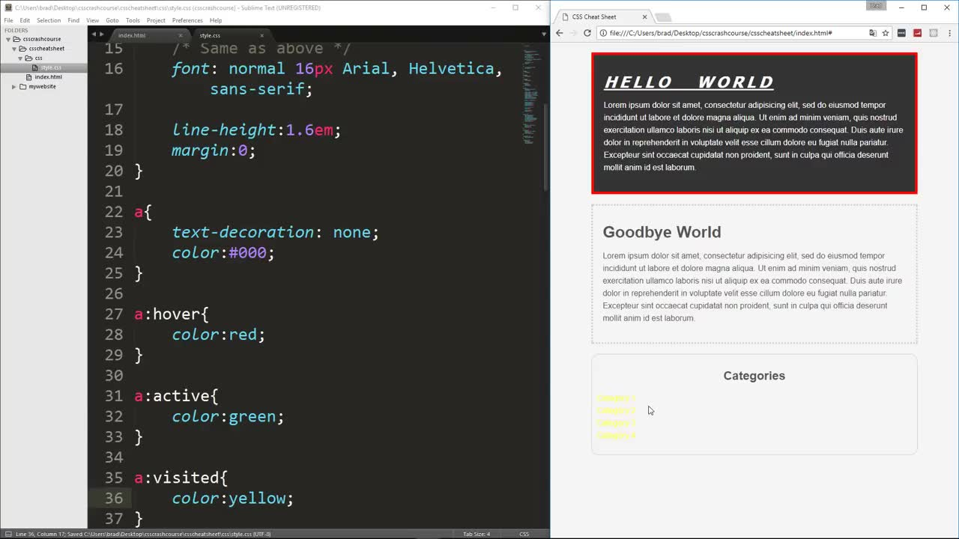
change link behavior

Slide 38
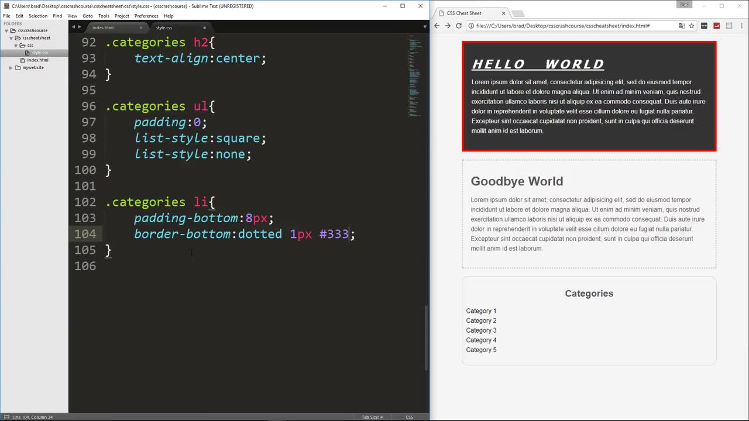
1
before

Slide 39
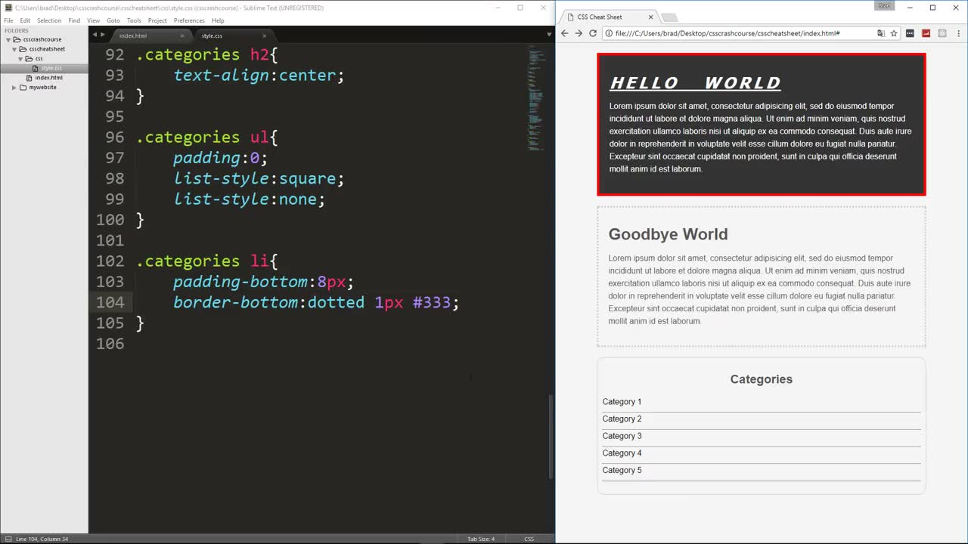
after
2

Slide 40
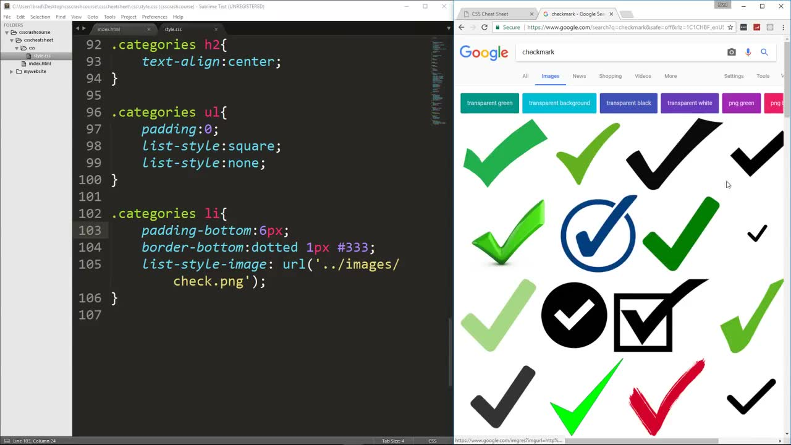

Slide 41
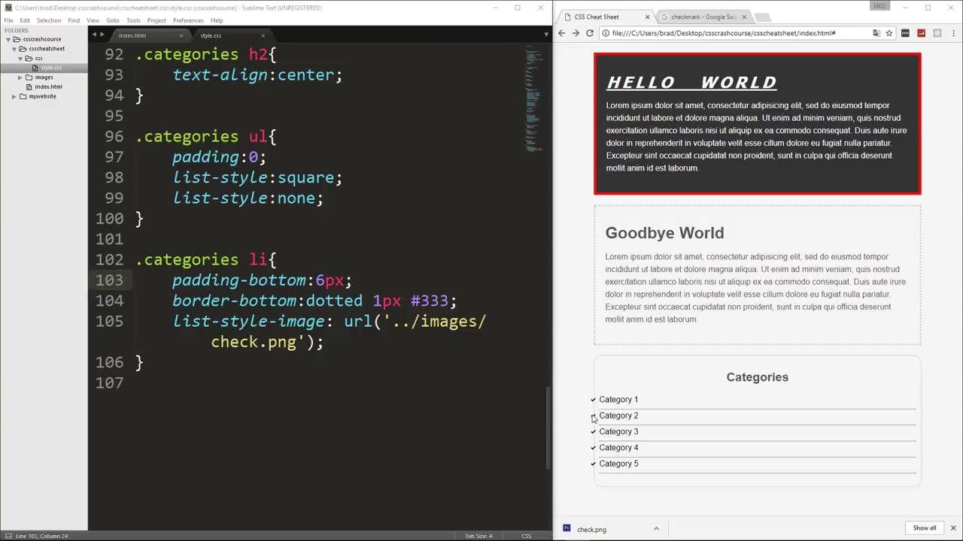

Slide 42
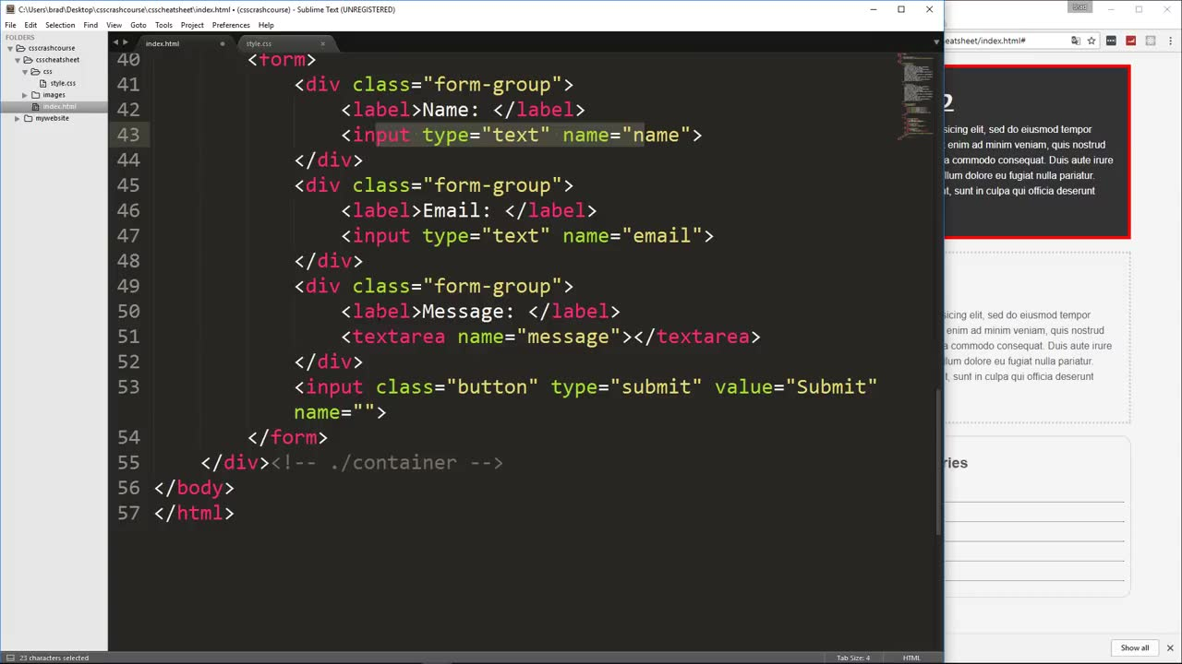

Slide 43
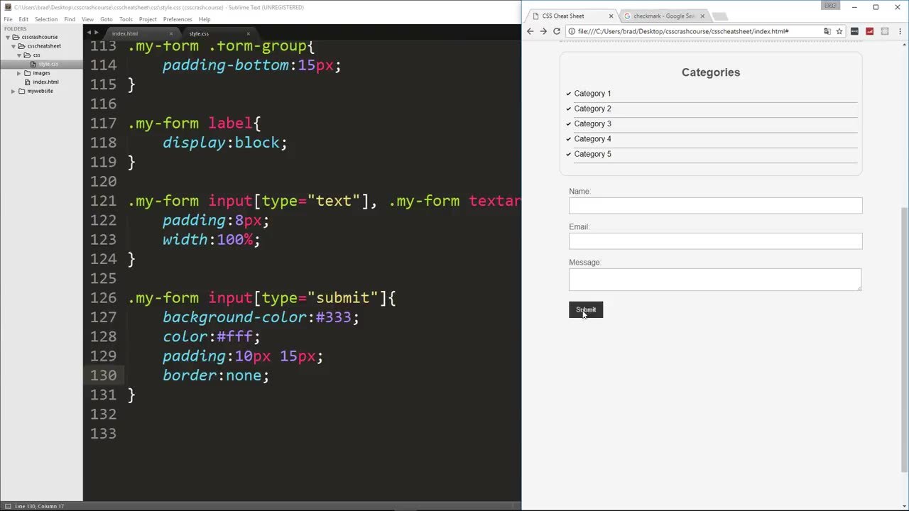

Slide 44
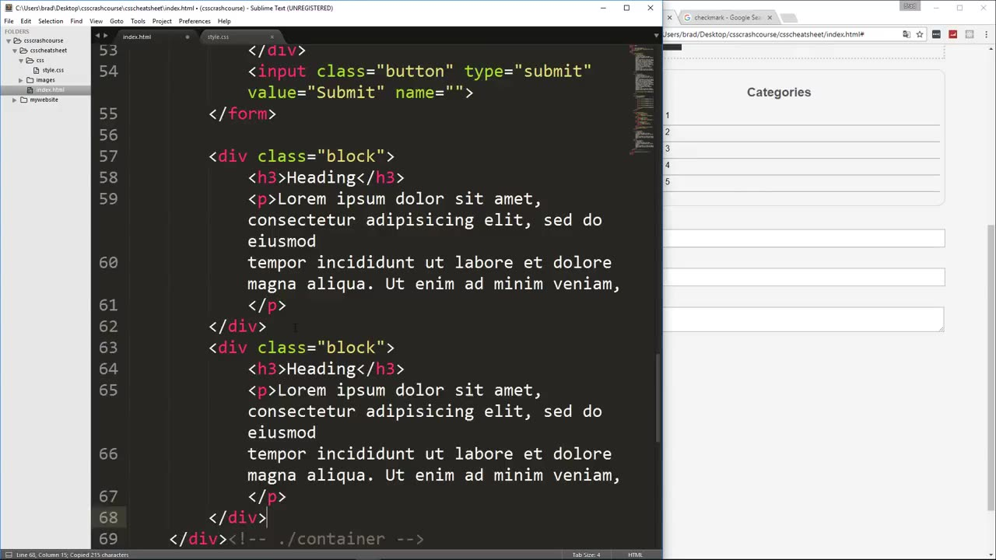
1 html

Slide 45
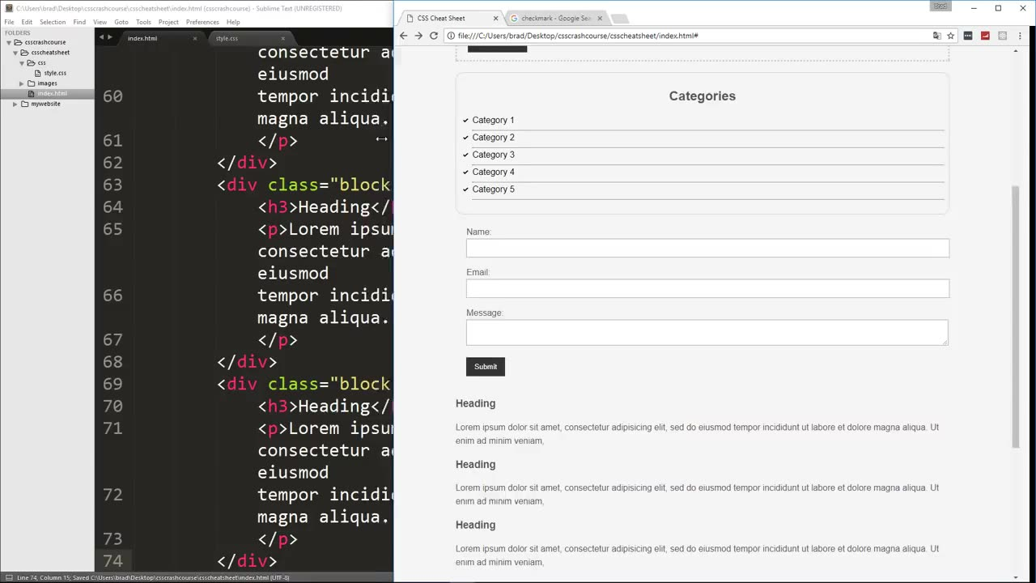
before
2

Slide 46
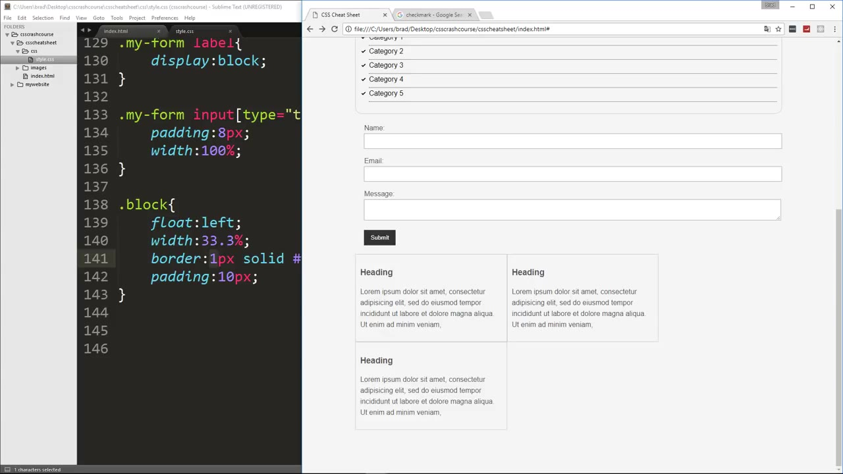
3
33.3%

Slide 47
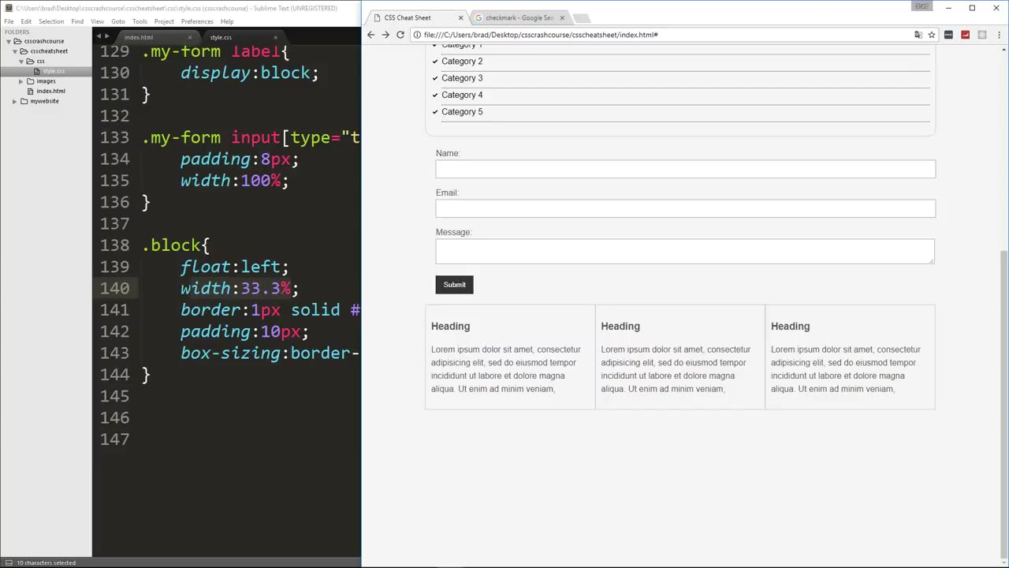
4e
after

Slide 48
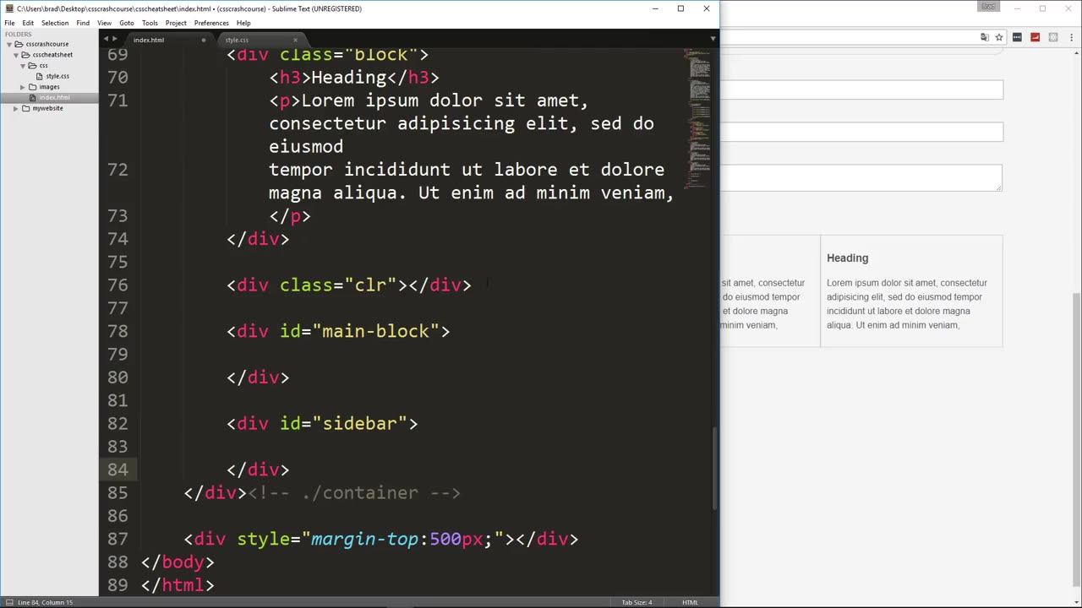
log #2
1

Slide 49
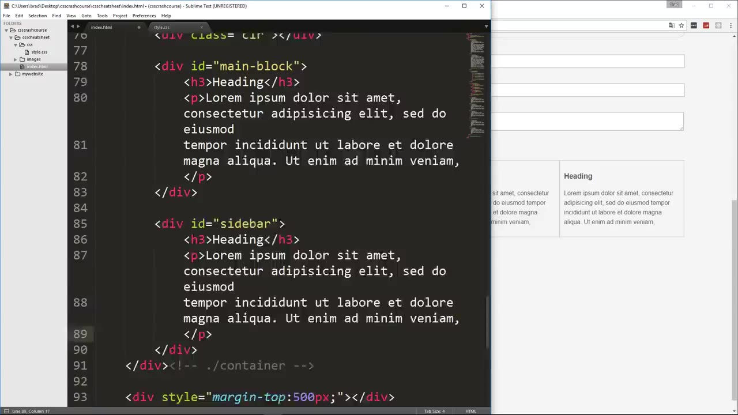

Slide 50
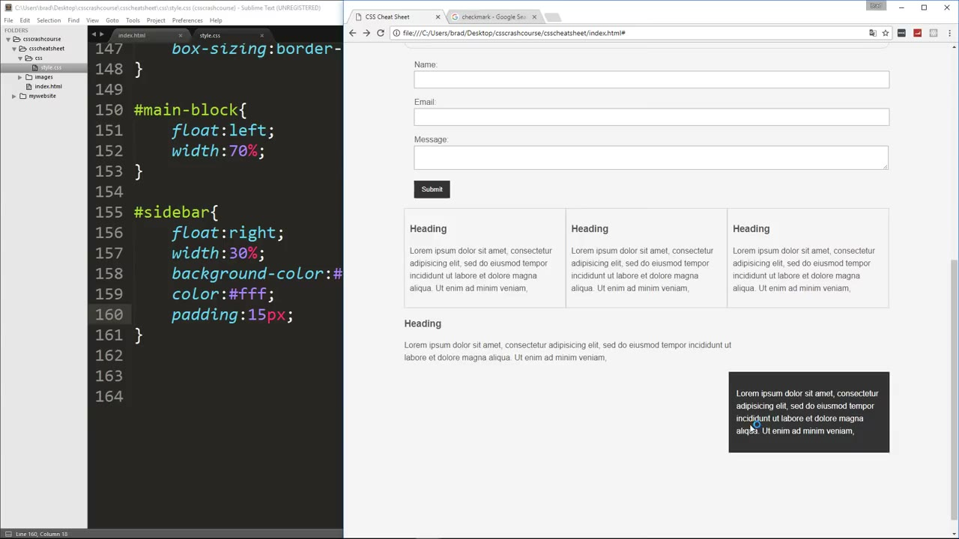
before
1

Slide 51
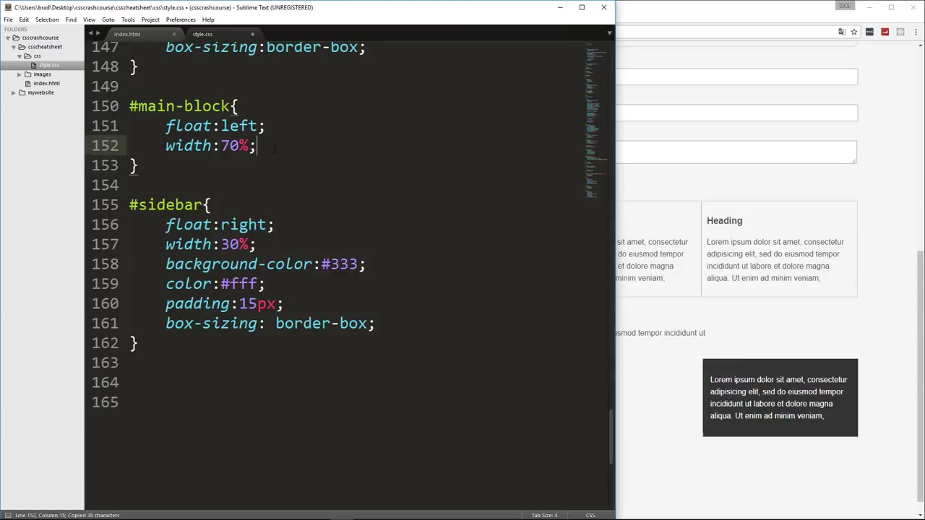
2

Slide 52

3
after

Slide 53
position

Slide 54


Slide 55

1 html

Slide 56

2
2

Slide 57

3e

Slide 58

add
兩個類別
fix-me
button

Slide 59

Q: 為甚麼在左邊

Slide 60


Slide 61


Slide 62

before

Slide 63

after

Slide 64


Slide 65


